Slide 1
An Introduction to Data Visualisation and Visual Demography in R 22-23 October 2014 Hilton Grosvenor Hotel, Glasgow
Dr Jon Minton
Applied Quantitative Methods Network (AQMeN)
University of Glasgow
Jonathan.minton@glasgow.ac.uk

Slide 2
Guiding Principles and Structure of this workshop
Day 1: Part 1
Theoretical
Why? What?
Day 2: Part 1
Day 2: Part 2
Practical
How?
Day 1: Part 2

Slide 3
Covered today
Morning
An introduction to ggplot2
Extended practical on using ggplot2
Afternoon
A talk on demographic visualisation
A choice: A) continue with the morning’s practical; or B) do some practical exercises on demographic visualisation

Slide 4
But first…
Any comments/ queries/suggestions about the material covered yesterday?
[Make notes here]

Slide 5
An introduction to ggplot2
The gg in ggplot2 stands for the ‘grammar of graphics’
The basic principle of the grammar of graphics was covered yesterday, within the definition of data visualisation.
Important key concepts:
Layers
Mapping rules
Coordinate systems
Aesthetics
Geometrics

Slide 6
What is the grammar of graphics?
A book by the statistician Leland Wilkinson
Provides a language/framework for thinking about and describing data visualisations.
Wilkinson has worked mainly with SPSS, and with colleagues at SPSS developed the program nVizn, which applies the ‘grammar of graphics’ approach
http://www.cs.uic.edu/~wilkinson/Publications/ibm.pdf
http://www.cs.uic.edu/~wilkinson/nViZn/nvizn.html
However, because of the increasing popularity of R, Wilkinson’s grammar of graphics principles have had more influence mediated through Hadley Wickham, the creator of the ggplot2 package

Slide 7
Hadley Wickham & ggplot2
One of the problems with R comes out of one of its advantages:
Open source means many packages;
But many packages means many contributors;
Many contributors means many different standards and approaches
Inconsistency, redundancy, reinvention
Hadley Wickham
Has developed a wide range of packages for R for helping to work with and explore data
These grew out of his PhD thesis.
http://www.cs.uic.edu/~wilkinson/nViZn/nvizn.html
Perhaps because of this packages by Wickham tend to have much more of a sense of cohesiveness than most packages. They each work well with each other and have complementary roles in the process of helping researchers gain insight from data.
ggplot2 is the main package Wickham has developed for the visual exploration of data. It is based on Wilkinson’s grammar of graphics ‘philosophy’, but involves a number of different features and uses some slightly different terminology

Slide 8
Using ggplot2
Uses a ‘Lego’ philosophy…
Data visualisations in ggplot2 are built up, piece by piece, using the ‘+’ symbol.
(Technically, this is an example of ‘operator overloading’)
At a minimum, the user needs to specify
The dataset
The aesthetics: mapping from variables to graphical elements)
The geometrics: the associations between graphical elements
Additionally, the user can specify:
Data transformations
Coordinate systems
Support layer elements
Facets

Slide 9
Description in Hadley’s words
A plot is made up of multiple layers
A layer consists of:
data;
a set of mappings between variables and aesthetics;
A geometric object; and
A statistical transformation
Source: https://www.youtube.com/watch?v=RHu5vgBZ1yQ

Slide 10
Facets
Facets are a very important and useful way of arranging data
Effectively they specify how to arrange multiple figures in a tabular format
Similar in principle to trellis/lattice plots (Cleveland) or small multiples (Tufte)
To use:
g2 <- g1 + facet_grid([arguments])
g2 <- g1 + facet_wrap([arguments])
The first argument defines the arrangement of the facets
See http://docs.ggplot2.org/0.9.3.1/facet_grid.html and the differences between:
p + facet_grid(. ~ cyl)
p + facet_grid(cyl ~ .)

Slide 11
Ggplot2: use within R
Two main approaches
qplot (quickplot): this allows people to be less specific about elements of the graphic, by making (usually) intelligent assumptions about the graphical elements that work best given the data. It uses similar arguments, and looks similar, to the basic plot function used in R’s basic graphics package.
ggplot: this is the main function used in ggplot2 to create a foundation for building your data visualisation on top of. At the minimum, the ggplot function just requires one object: the dataset to be used. All other instructions required can then be added to this first object separately.

Slide 12
Something else to note
If you assign a composite of a ggplot object to another object, you won’t print it on the graphical device.
Printing is a ‘side effect’ of a function. This is caused in two ways:
Use the print function with the ggplot object as the argument, e.g. type
print(g3)
Type the ggplot object without assigning it anywhere, e.g. type
g3

Slide 13
The practical: Play with ggplot2
The practical: In groups of (ideally) three, choose a dataset, and use ggplot2 to explore it.
Discussion:
If ggplot2 is Lego, then this practical should be play, not work.
I won’t tell you what to build, or how to build it
However… some suggestions:
Use a dataset that you are actively interested in if possible.
SAVE THE CODE as you generate it
Be scientific in your play: look at changing only one thing at a time
Have designated roles within your team: work to your strengths
Consider drawing out the mapping rules on pen and paper first

Slide 14
ggplot2: The stairs or the escalator?
The Stairs: If you want to use ‘pure’ ggplot2, do so.
However, if you are new to both R, and to ggplot2, and you are not too comfortable with command line interfaces, this might be too many hurdles at once. Luckily there’s GUI alternative that allows you to start to understand the core principles of ggplot2, without having to also work out how to specify it through code:
The Escalator: http://rweb.stat.ucla.edu/ggplot2/
If you’re using the Escalator, please open the code panel so you’ll know how to use the stairs later.

Slide 15
Getting data
Hopefully, some data kindly contributed by fellow delegates should be available on the GitHub repository.
https://github.com/JonMinton/AQMEN_Data_Vis_Workshop
Otherwise, data are available within many R packages, including ggplot2; and the datasets package
Typing data() to show all datasets available on your computer.
Installing more packages will increase the list.
The package argument in data() allows you to specify only those datasets in a package
To move a specific dataset into current workspace, type the dataset name as the only argument in the data() function
If you’re going to use the web based GUI, you will need to export the data from R proper, and import the data to the GUI. Just ask me, and I will help. (And if you’ve been helped, help others!)

Slide 16
Suggested phases
Phase One:
Form a team; name the team; decide on roles; decide on approach; decide on data.
Phase Two:
Start to understand the format and dimension of the data; decide on the mapping rules (variables and aesthetics); geometrics (lines, points, bars etc) and so on; sketch out what this might look like.
Phase Three:
Research how this mapping can be achieved in ggplot2 (n.b. not everything can be); search for ‘recipes’ and modify to taste; write up code with comments so you can understand and explain the development process.
Phase Four:
Explore how to modify the cosmetic features of ggplot graphics, how to save in different formats; explore the effect of using different geoms on the same variables, or different variables on the same variables; incorporate ggplot2 images in a report or powerpoint presentation.

Slide 17
Phase One
Team Names
[fill in here]
Progress, challenges, achievements, ideas

Slide 18
Phase One
Team Names
[fill in here]
Progress, challenges, achievements, ideas

Slide 19
Phase Two
Team Names
[fill in here]
Progress, challenges, achievements, ideas

Slide 20
Phase Three
Team Names
[fill in here]
Progress, challenges, achievements, ideas

Slide 21
Phase Four
Team Names
[fill in here]
Progress, challenges, achievements, ideas

Slide 22
Summary
What have we learned?

Slide 23
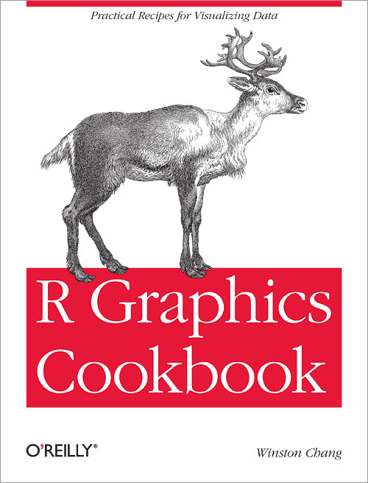
Next steps
Practice, Practice, Practice
A very strong (but occasionally unfriendly) online community
This book:
Chang, W (2012) R graphics Cookbook, O’Reilly
Recommended by Wickham in preference to his own book

Slide 24
After lunch
A talk on demographic visualisation
A choice:
Either continue practicing ggplot2
Or start to learn how I produced some of the visualisations in the talk. [More niche?]

Slide 25

Demographic Scars & Demographic Futures
Jonathan Minton
University of Glasgow

Slide 26
Presentation Structure
Origins of the research
Co-plots
Dead Parrots & Demography
Thoughts about statistics and data visualisation
Contour plots
Practical considerations
A live demonstration (If there’s time, and I’m feeling lucky…)
The future

Slide 27
1) Origins of the research
“The visualisations developed from a PhD in Sociology & Human Geography at the University of York, and a friendly argument with his former PhD supervisor, Danny Dorling, about the interpretation of two lines on a graph.”
http://blog.oup.com/2013/09/demographic-landscape-good-news/

Slide 28
1) Origins of the research Reasons for data visualisations of demographic data
Substantive
To get a better sense of how pension liabilities have ‘crept up’ on richer nations over time due to increased longevity
To see how life has become less ‘risky’ over time
Methodological
To avoid over-reliance on summary statistics
To perform rich, nuanced exploratory data analysis of a lot of data

Slide 29
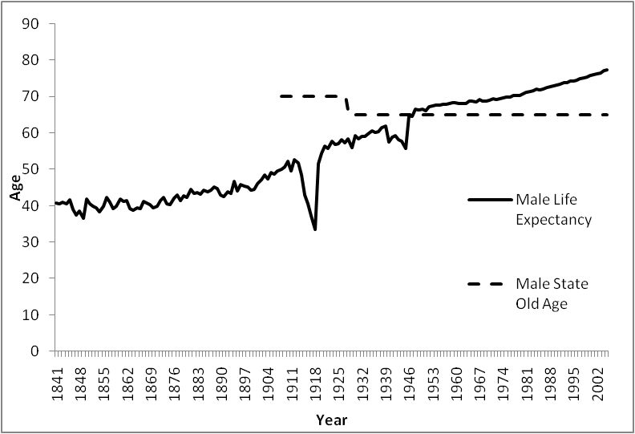
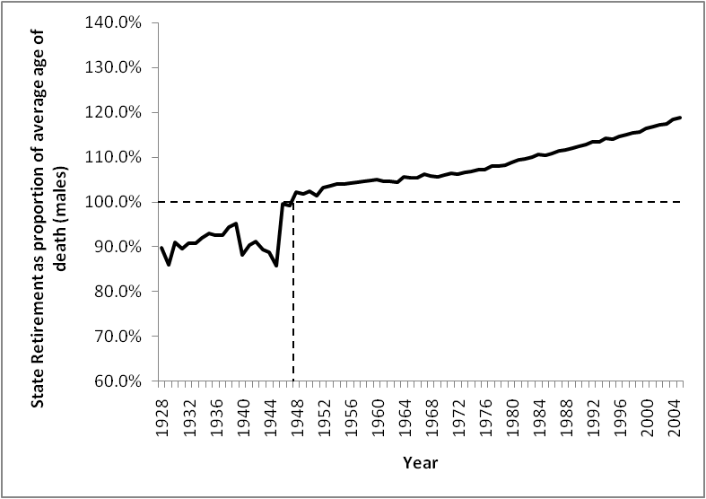
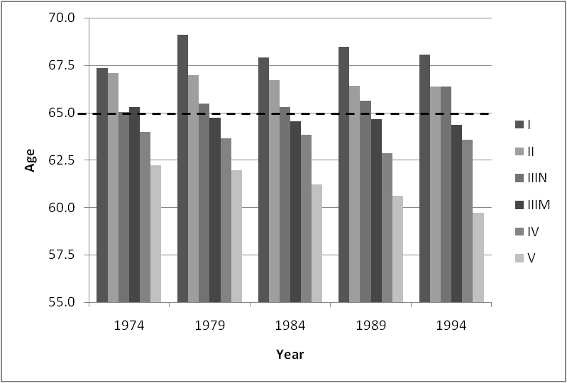
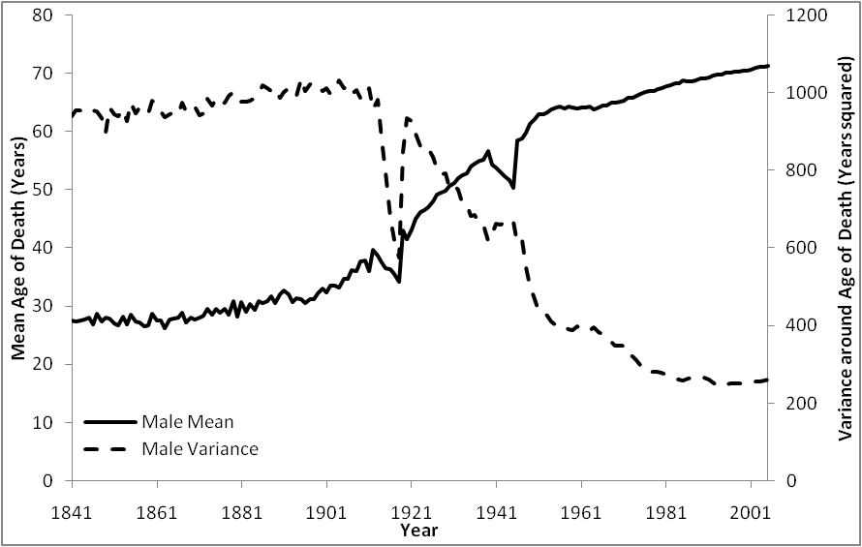
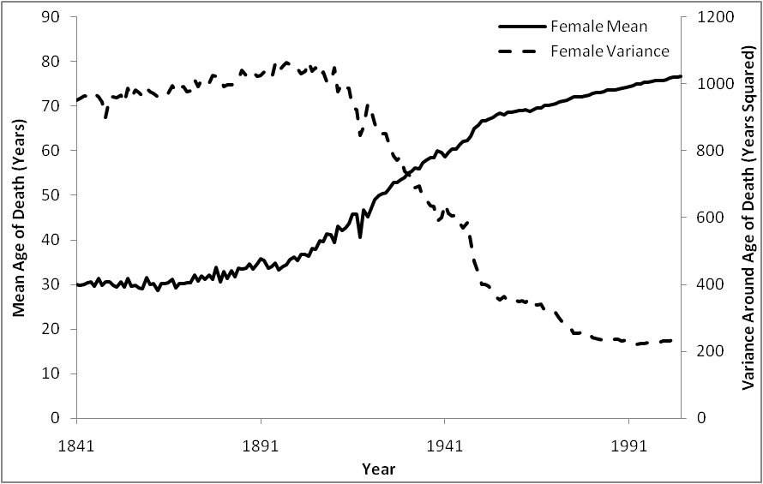
1) Origins of the research

Slide 30
2) Coplots

Slide 31
2) Coplots

Slide 32
The argument
Variance is not life riskiness, it’s infant mortality.
Variance may reduce entirely due to reduced infant mortality, without any reduction in mortality risk at other ages.

Slide 33
2) Conditional co-plots

Slide 34
2) Conditional Coplots

Slide 35
2) Further thoughts
The co-plots are dependent on the choice of threshold.
The dangers:
Over-reduction
Devil-’s-in-the-detail Dependence
Time for a re-think.

Slide 36
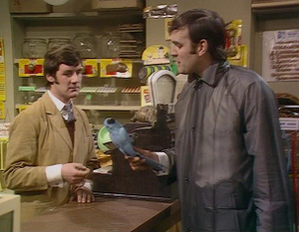
3) Dead Parrots

Slide 37
3) Demography: The three mortality effects
Age effects
p(death) = f1(age)
Period effects
p(death) = f2(year)
Cohort effects
p(death) = f3(age*year)
But it’s not this simple: each effect is non-static over time

Slide 38
3) Demography: Areas of substantive importance
Micro-problems
Parental investment
Investment in retirement
Macro-problems
Labour market & dependency ratios
Pensions
Healthcare

Slide 39
4) Statistics & Data Visualisation
My perspective
The main benefit of statistical inference is (honest) data reduction
Data reduction is needed because people can’t cope with masses of information in making decisions
BUT data do not need to be reduced as much if it is presented effectively
Demographic Data Visualisation
‘Thousands of Data at a Glance’ (Vaupel et al 1987)

Slide 40
4) The Lexis Surface
Lexis Surfaces
x axis: age
y axis: year
z axis: value associated with {age, year} configuration
Z could be
Population count
Death count
Morbidity count/rate (But do you trust the morbidity data?)
‘Economic’ variable such as median income (But do you trust the economic data?)
In my case:
Crude death rate : Death Count/Population Count

Slide 41
4) The Data Source
Human Mortality Database
48 datasets from 37 countries, some going back to the 18th century

Slide 42
4) The Method: Contour plots

Slide 43
4) Question: Why not a bitmap?

Slide 44
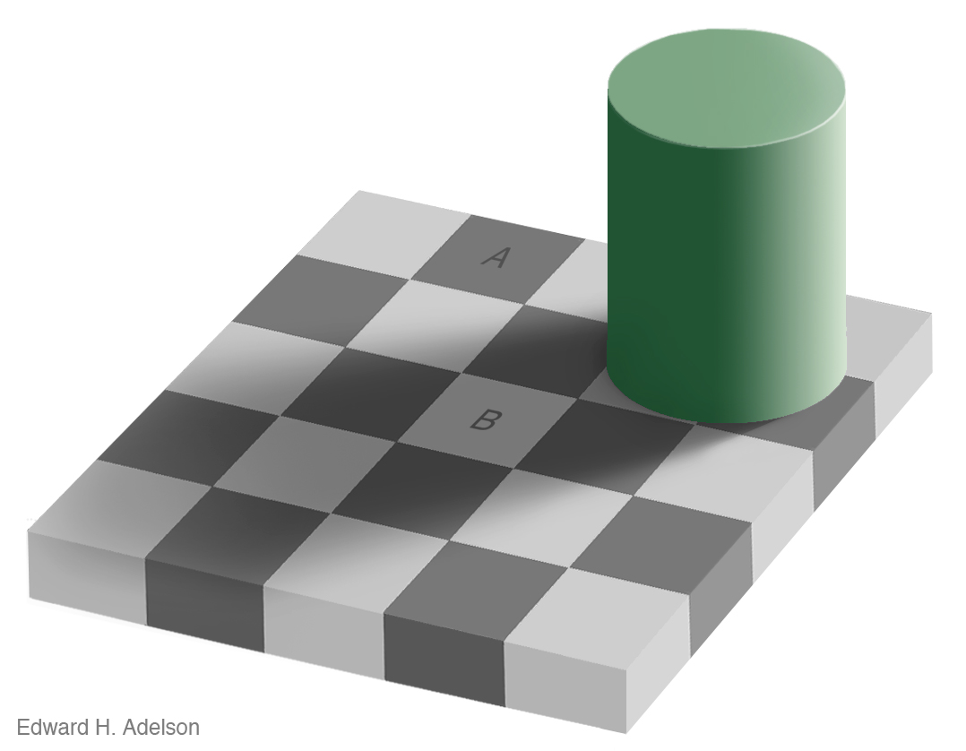
4) Answer: Because of this.

Slide 46
Age

Slide 47
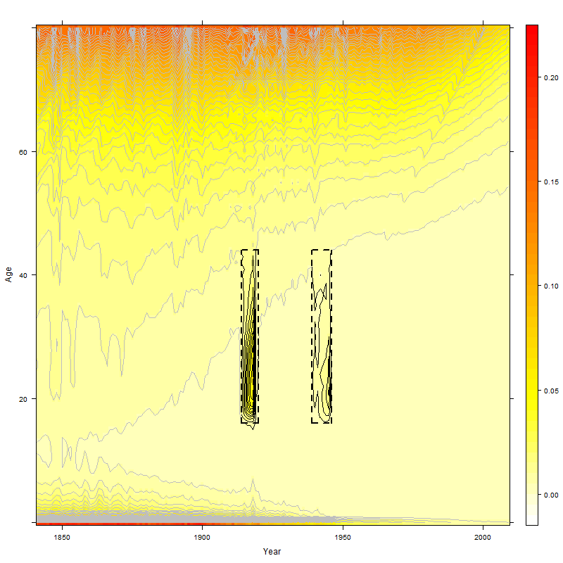
Period

Slide 48
Cohort

Slide 49
Natural Experiments

Slide 50
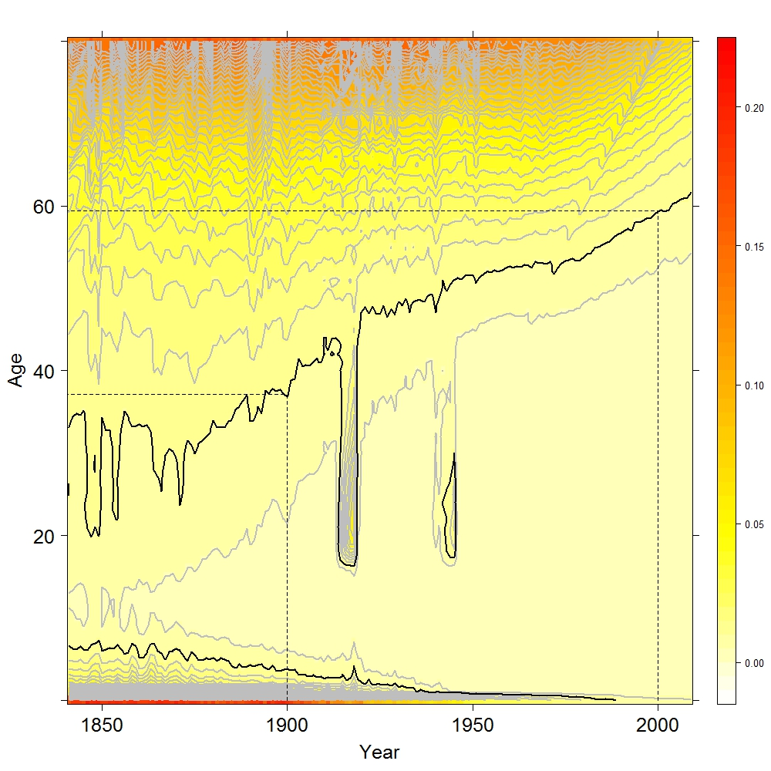
Trends: Following a Contour

Slide 51
Male Mortality & The Collapse of Communism

Slide 52
The Long Arc of History

Slide 53
Italian Bathtubs: Unlogged

Slide 54
Italian Bathtubs: Logged

Slide 55
More Recent Data: Switching to the Logarithmic Lens

Slide 56
More Recent Data: Switching to the Logarithmic Lens

Slide 57
USA: Male & Female Log Mortality

Slide 58
Unexpected Patterns

Slide 59
Using shaded contour plots to estimate bathtub curves
These figures show how ‘bathtub curves’, mortality rates as a function of age, can be read from contour maps.
The red and blue lines in figure a indicate two planes which cut the landscape at right angles to both age and year. The corresponding red and blue lines in figure b effectively shows what the cross-sections formed by ‘cutting’ these surfaces along the planes would look like, i.e. they are tomographs, as commonly used in medical imaging.
The bathtub curve public health researchers really want to be able to estimate is that associated with the thin, dashed purple line in figure a. The corresponding tomograph produced would be the bathtub curve which will be experienced by a new cohort, in this those case born in 2008.
Although we do not have the data to produce the bathtub, we can estimate it by extrapolating the contours produced from the data we do have. This is likely to produce better estimates for the 2008 cohort than the alternatives shown here.
Jonathan Minton
University of Glasgow
Jonathan.minton@glasgow.ac.uk
24 October 2013
2008
2089
1929
2008
a) Contour plot of mortality surface for Males, England & Wales with two coloured lines indicating the 1929 cohort (red), and a synthetic cohort (cross section) based on age-related mortality in 2008 (dashed blue line).
b) Mortality as a function of age for the two colour lines added to figure a

Slide 60
Current Publications
Minton, Vanderbloemen, Dorling (2013)
‘Visualising Europe’s Demographic Scars with Coplots and Contour Plots’, International Journal of Epidemiology
http://www.ncbi.nlm.nih.gov/pubmed/24062300
Minton (2014a)
‘Logs, Lifelines and Lie Factors’, Environment & Planning A
http://www.envplan.com/abstract.cgi?id=a130208g
Minton (2014b)
‘Real Geographies and Virtual Landscapes’, Spatial & Spatiotemporal Epidemiology
http://www.sciencedirect.com/science/article/pii/S1877584514000173
Minton (2014c)
‘If Europe were a country…”, Environment & Planning A
Accepted
Minton (2014d???)
‘Hunting Demographic Ghosts’, Environment & Planning A
Under review

Slide 61
Further Research Avenues
Visualisation Approach
Graphics engines
3D printing
Modelling
Formalising estimation of counterfactuals
Comparison between nations
Sources of Data
Population Statistics
World Health Organisation
Human Fertility Database
But… hundreds of visualisations are already available.
Why not develop and explore your own?

Slide 62
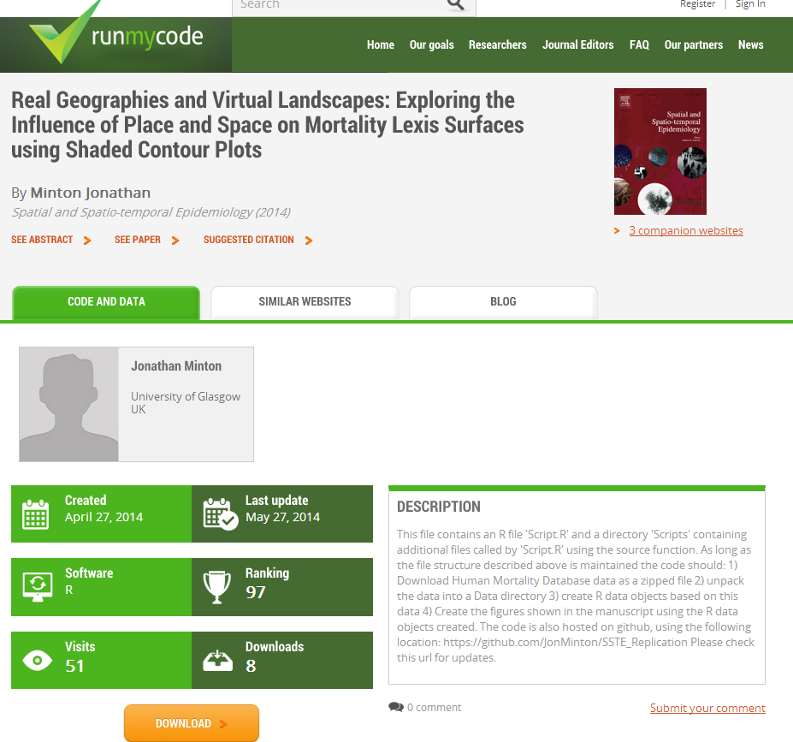
RunMyCode & GitHub
https://www.sheffield.ac.uk/scharr/sections/heds/ije
http://www.runmycode.org/companion/view/631

Slide 63
RunMyCode & GitHub
https://www.sheffield.ac.uk/scharr/sections/heds/ije
http://www.runmycode.org/companion/view/631
The SSTE Paper
The GitHub Repo

Slide 64
The code itself
Fetch HMD Zipfiles
Produce death rate data for each country
Automate producing and labelling of coplots and Lexis plots

Slide 65
Structure of Code
Clear workspace
rm(list=ls())
require(RCurl)
require(repmis)
require(httr)
require(digest)
require(devtools)
require(lattice)
require(latticeExtra)
require(downloader)
require(xlsx)
require(rgl)
require(tcltk)
Run_3D_Vis = TRUE
OlderData=TRUE
Replicate_Figures = FALSE
source("Scripts/Functions.R")
source("Scripts/Manage_Prerequisites.R")
if (Replicate_Figures){
source("Scripts/Make_Figures.R")
}
Load packages (Will need to use install.packages first time)
Flags
(Change to TRUE or FALSE)
Unconditional scripts
Unconditional scripts

Slide 66
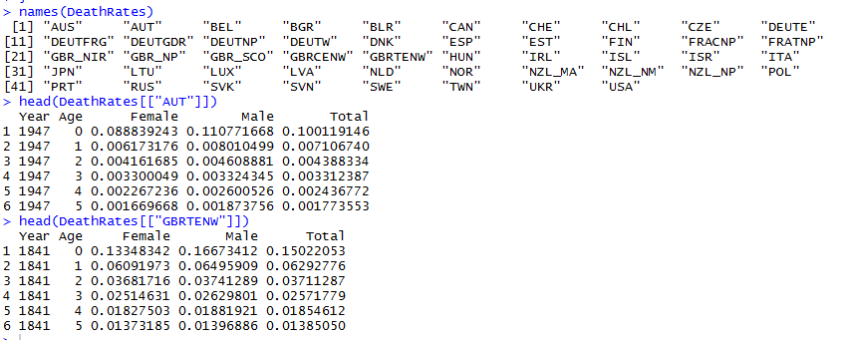
Working with R List Objects
Lists: Magical containers

Slide 67
Producing the contour plots
Lattice package; contourplot function
this.ds <- DeathRates[["NOR"]]
this.ds <- subset(this.ds, Age < 81)
tiff("Figures/Figure07.tiff", height=1000, width=1000)
print(contourplot(
Male ~ Year * Age,
data=this.ds,
region=T,
col.regions=rev(heat.colors(200)),
cuts=50,
main="Norway, Males")
)
dev.off()
Male ~ Year * Age
Female ~ Year * Age
Total ~ Year * Age
Female ~ Age * Year
log(Male) ~ Year * Age
I( log(Male) – log(Female))
~ Year * Age
Other
possible
formulae

Slide 68
Structure of Code: An Experimental Addition
Clear workspace
rm(list=ls())
require(RCurl)
require(repmis)
require(httr)
require(digest)
require(devtools)
require(lattice)
require(latticeExtra)
require(downloader)
require(xlsx)
require(rgl)
require(tcltk)
Run_3D_Vis = TRUE
OlderData=TRUE
Replicate_Figures = FALSE
source("Scripts/Functions.R")
source("Scripts/Manage_Prerequisites.R")
if (Replicate_Figures){
source("Scripts/Make_Figures.R")
}
if (Run_3D_Vis){
tmp <- Make_3D_Plot.UI(DeathRates)
}
Load packages (Will need to use install.packages first time)
Flags
(Change to TRUE or FALSE)
Unconditional scripts
Unconditional scripts
WARNING: Experimental

Slide 69
fin

Slide 70
Final Practical
Option A
Go to the RunMyCode link provided earlier, and run my code; explore the code and how the data and figures are generated; create your own variations of these image
Option B
Continue working with and exploring ggplot2; either by starting afresh with a new dataset and project, or by further developing and refining the morning’s project
I won’t be offended if most people go for Option B. This is your decision about how best to use your time.

Slide 71
Notes on the afternoon’s practical
[Make notes here]

Slide 72
Summing up
A workshop of two days
Two days of two halves
Yesterday: AM
Notes
Yesterday: PM
Notes
Today: AM
Notes
Today: PM
Notes
Ideas for next steps
Graphical theory
R
ggplot2
lattice
Collaborative working: any partnerships formed today?
Any final suggestions/Ideas?
Notes

Slide 73
Finally…
Thank you for attending! I hope you found the workshop both informative and enjoyable.
Feel free to contact me:
Jonathan.minton@glasgow.ac.uk

